Slide 1
Efficiency in energy engineering
Raj Pala,
rpala@iitk.ac.in
Department of Chemical Engineering,
Associate faculty of the Materials Science Programme,
Indian Institute of Technology, Kanpur.

Slide 2
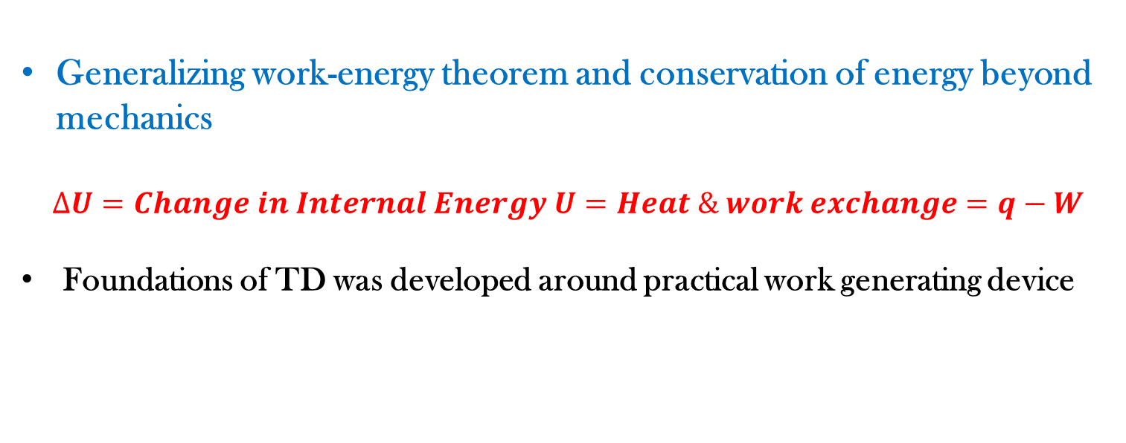
Energy, work & heat in Thermodynamics
Generalizing work-energy theorem and conservation of energy beyond mechanics
$$∆U=Change in Internal Energy U=Heat \& work exchange=q−W$$
Foundations of TD was developed around practical work generating device
ΔE = ΔU + ΔKE + ΔP

Slide 3

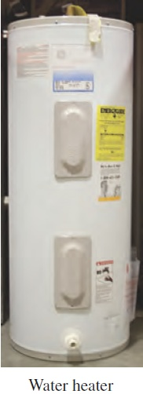
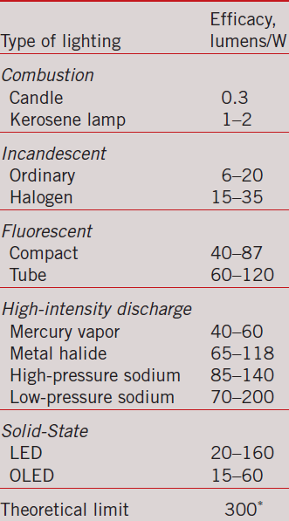
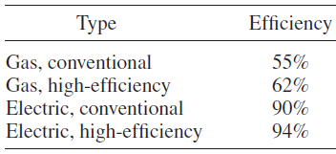
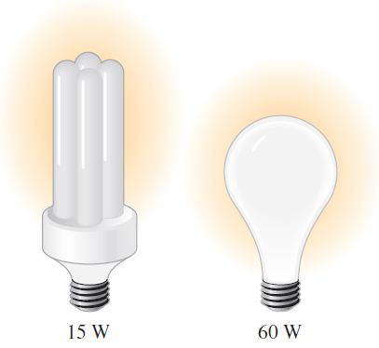
Practical efficiency
Fig: Cengel & Boles: TD

Slide 4
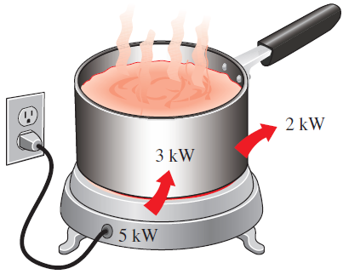
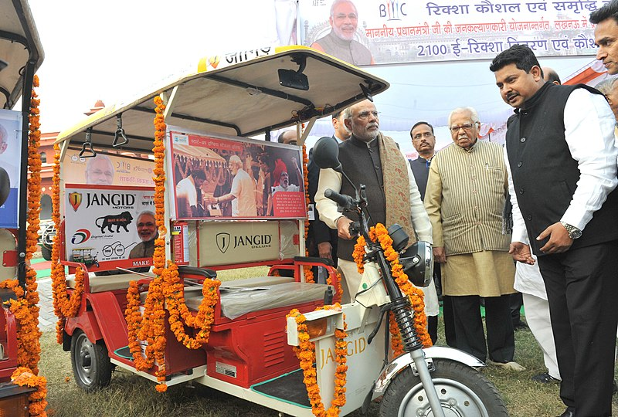

Analysis of practical efficiency
Environmental cost of energy conversion
PM: Will we be able to decrease pollution with E-rickshaw?
Governor is thinking…It depends on how E-rickshaw is charged
Fig: Cengel & Boles: TD

Slide 5
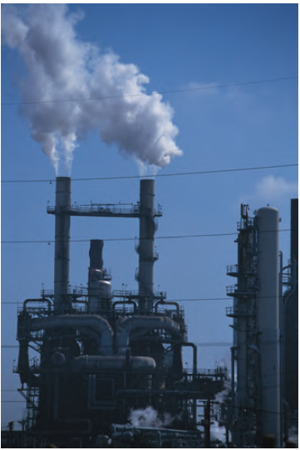
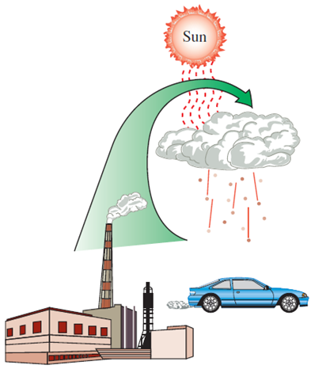
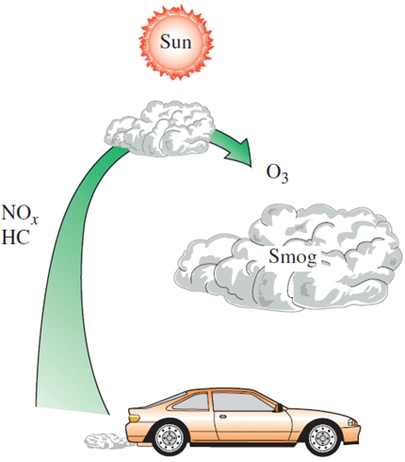
Analysis of practical efficiency
Fig: Cengel & Boles: TD

Slide 6

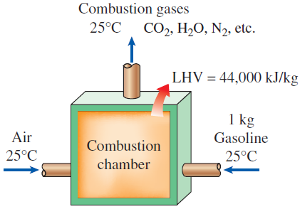
Heating value of fuels
Lower heat value (LHV): Water Vapor
HHV: Heat released on water vapor condensation is also utilized
Fig: Cengel & Boles: TD

Slide 7
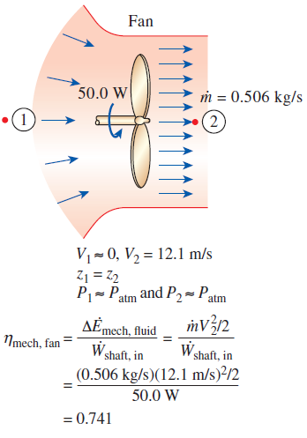

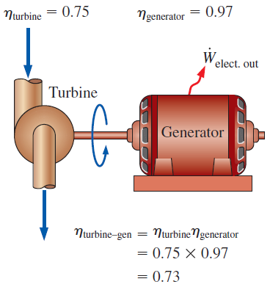
Efficiency in mechanical and electrical devices
Fig: Cengel & Boles: TD

Slide 8
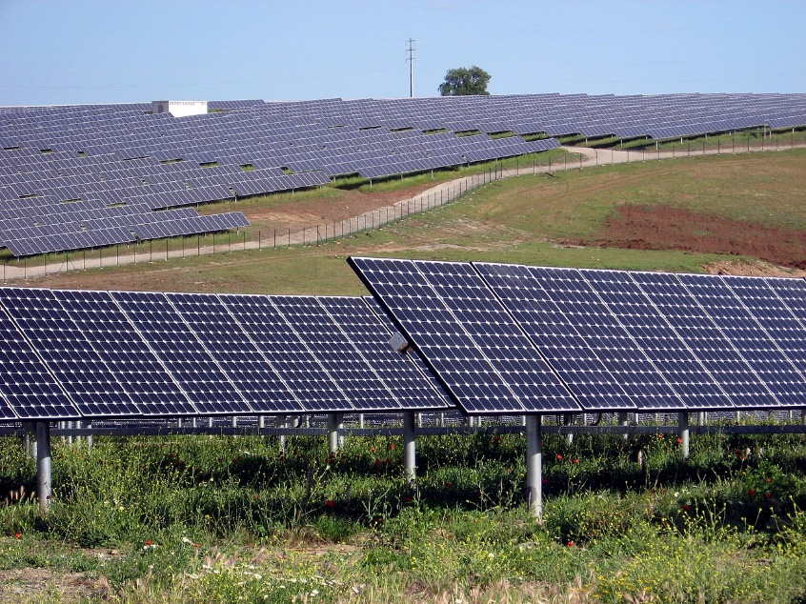
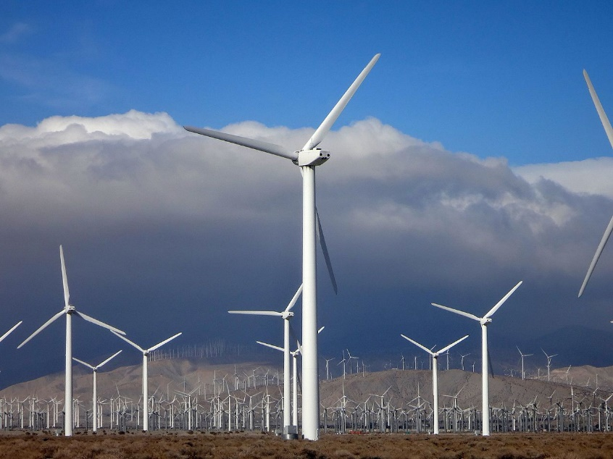
Practical vs. fundamental efficiency limits
Solar (“Shockley-Queisser limit”) & wind “farms”
“Inherent” 2nd TD law limitation in converting heat to work-Carnot limitation
Electrochemical energy conversion (fuel cells/batteries) is beyond Carnot limitation
Figs: Wiki

